Slide 1

Store Sales: Analyzing and predicting (MVP)
Abdulrahman AL-SALLUM

Slide 2
The Data
Data Cleaning and visualization
Modelling and next steps
Content

Slide 3
The Data
Data Cleaning and visualization
Modelling and next steps
Content

Slide 4
What is the Data we are working with ? And what are trying to do?
The data is from the Big Mart stores, it was collected in 2013 which shows the sales of different products from different outlets. The Goal is to have better understanding of the data and what outlets perform better than others. After this we can have a model to predict the sales for the upcoming year .
Features of the data :
Product ID : unique product ID
Weight : weight of products
Fat Content : specifies whether the product is low on fat or not
Visibility : percentage of total display area of all products in a store allocated to the particular product
Product Type : the category to which the product belongs
Outlet ID : unique store ID
Establishment Year : year of establishment of the outlets
Outlet Size : the size of the store in terms of ground area covered
Location Type : the type of city in which the store is located
Outlet Type : specifies whether the outlet is just a grocery store or some sort of supermarket
Outlet Sales : (target variable) sales of the product in the particular store

Slide 5
The Data
Data Cleaning and visualization
Modelling and next steps
Content

Slide 6
Data Cleaning
Missing Values
The data columns were in a good shape and consistent. But there are many missing data in two columns (Product Weight and Outlet Size) around 2500 missing values.
Approaches to deal with missing values
Here we have two data types to deal with:
Product Weight which is numerical.
Outlet size which is categorical (small – medium – large)
For the numerical data (product weight) we can use many methods to fill it ( average , last value … etc )
For the categorical data (Outlet size) we can use the mode (the most common size) to fill the missing.
There is one smarter way to fill them both, Since we have another columns like product ID and outlet ID, we can link them together to get the correct data. For Example: if a product ID = 23 , and its weight = 1.5 KG. then we know this product will always have this weight and we can use this with all the products and outlets.
For this MVP, the first two approaches were followed since the later isn’t easy programming wise.

Slide 7
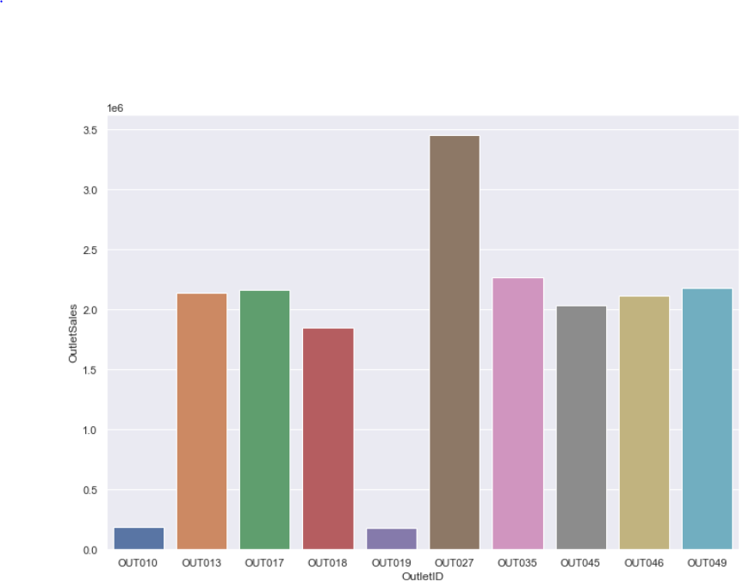
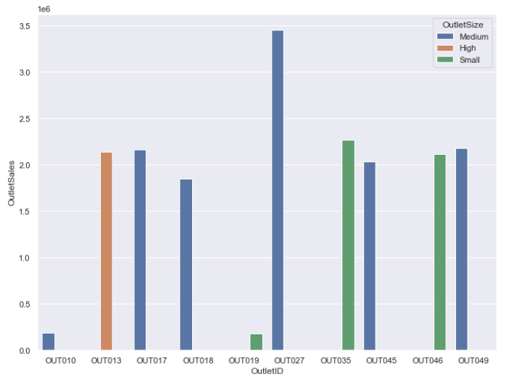
Data Visualization
What Outlet was the best in sales?
How the Outlet size differ ?

Slide 8
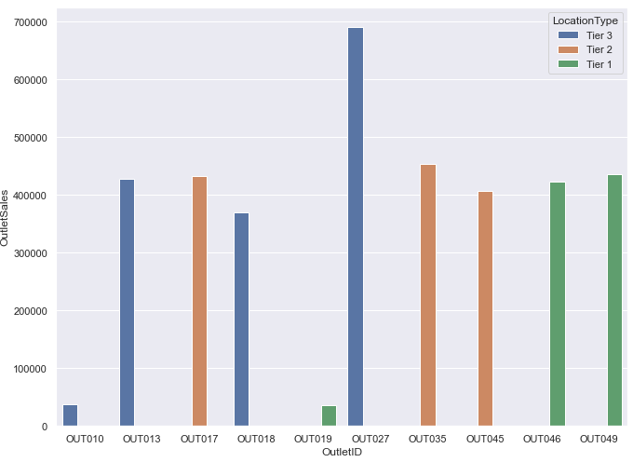
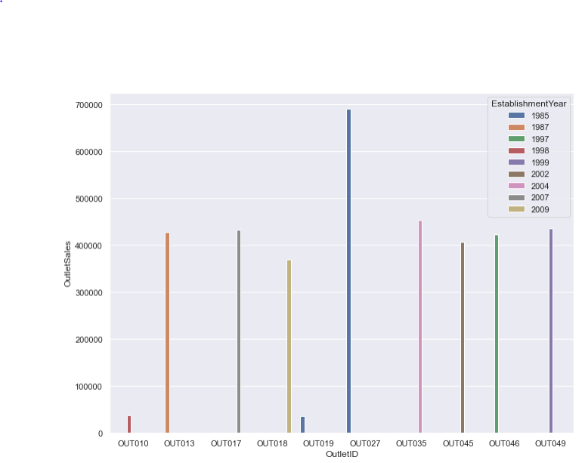
Data Visualization
How the location differ in sales
Does the year make a difference ?

Slide 9
The Data
Data Cleaning and visualization
Modelling and next steps
Content

Slide 10
Modelling
What has been done :
Drop unneeded column such is Product ID
This is regression prediction; we will convert all categorical columns to dummies
Define X (the data without the target) and Y(the Target)
Scale X
Used Algorithm: Linear Regression .
Final score = 58%
Next steps:
The score is low, next steps to improve it:
Better Data cleaning.
Dig more into the data and try to spot more missing values.
Use cross Validation on the data.
Try different scale methods.
More models for prediction.

